Slide 1

Cougar P.A.W.S.
Parents and Teachers working together!
Planning a Way to Success

Slide 2

Outcomes
Review & Reflect on the Data: Reading & Math Inventory/Georgia Milestones
Set a SMART Goal!
Plan a Way to Success – Resources to Support progress at home
Notes:
Explain the purpose and process for tonight’s session.
Introductions
Refer to information in folder

Slide 3

Provides teachers with actionable data on students’ reading level and growth.
Provides a Lexile measure that connects the reader to reading material appropriate for independent practice.
Lexile measures guide students in the right direction
Lexile measures target reading as an area in need of intervention
Notes:
Key understanding is that the Lexile score that a student receives helps teachers, parents and the student determine whether they are on track for their grade level as well as find text that is appropriate for their grade level.
Teachers use it to determine interventions that may be needed, grouping students and determining the level of support needed when presenting students with content specific text.
Parents and students can use the Lexile level to choose text that is appropriate for their independent reading and practice.
PAWS II
Quick review

Slide 4
Reading Inventory Growth (2017/18 School Year)
58% Basic/
Below
Notes:
Highlight successes so far! Reduced below basic by 3% and basic by 1%. Increased advanced by 4%.
Area of concern: Decreased proficient by 9%

Slide 5

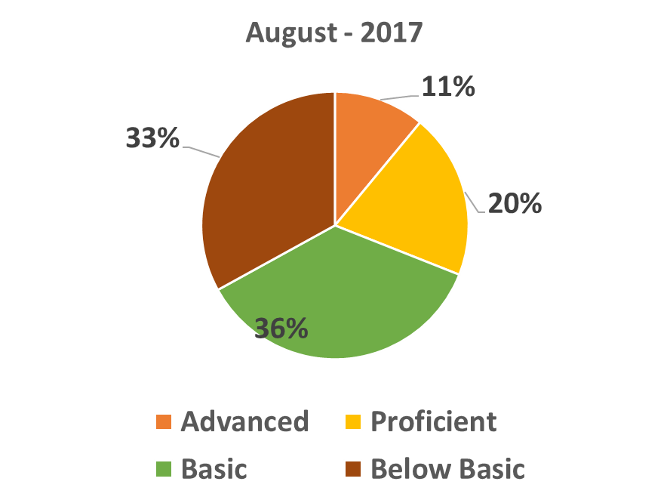
6th Grade Performance December2017
31% Prof./Adv.
36% Prof./Adv.
64% Basic/Below
69% Basic/Below
Notes:
There is a sense of urgency and concern with the results a so many of our students need to increase their Lexile score in order to meet the challenges of grade level text.
Connect parents as to why it is so important that we give them an opportunity to look at their child’s data and consider ways in which they can support their reading growth at home.

Slide 6

7th Grade Performance December 2017
57% Basic/
Below
Notes:
Similar increase as 6th grade of 4%
There is a sense of urgency and concern with the results a so many of our students need to increase their Lexile score in order to meet the challenges of grade level text.
Connect parents as to why it is so important that we give them an opportunity to look at their child’s data and consider ways in which they can support their reading growth at home.

Slide 7
8th Grade Performance December
50% Prof./Adv.
50% Basic/
Below
Notes:
There is a sense of urgency and concern with the results a so many of our students need to increase their Lexile score in order to meet the challenges of grade level text.
Connect parents as to why it is so important that we give them an opportunity to look at their child’s data and consider ways in which they can support their reading growth at home.

Slide 8
Why does it Matter?
Struggling readers
  tend to struggle in all content areas
  may have classroom discipline issues
  often disengage from instruction or lack motivation to complete assignments or participate
  tend to perform poorly on standardized tests
  may drop out of high school – Need 4 credits of English to graduate
  may require remedial classes in college which adds to the cost of tuition
Notes:
Conclude the discussion of the RI and Lexile scores by helping parents see the impact of students who score at basic or below basic.
It is probably a good idea to read through this slide.

Slide 9

Why does it Matter?
Advanced readers
  Tend to read too fast
  Struggle with critical thinking about a text
  Struggle to find appropriate books for their age level
  Can be unmotivated to read
  Often lack the stamina to research and read non-fiction text
Notes:
This slide addresses the concerns that we have with students who score at an advanced level.
Advanced students find grade level reading “easy” and often are quick to grasp the big ideas. It is when they are challenged by more challenging text that they resist close reading strategies that require them to slow down, make connections to their prior knowledge or other texts they have read as well as use evidence from a text to support their conclusions or inferences.
It is important that we look for ways to stretch our students and get them to think more deeply about the challenging texts that they are presented with.

Slide 10

Lexile and Grade Level Equivalents
Grade | Below Basic | Basic | Proficient | Advanced
4 | BR-539 | 540-739 | 740-944 | 945+
5 | BR-619 | 620-829 | 830-1014 | 1015+
6 | BR-729 | 730-924 | 925-1074 | 1075+
7 | BR-769 | 770-969 | 970-1124 | 1125+
8 | BR-789 | 790-1009 | 1010-1189 | 1190+
9 | BR-849 | 850-1049 | 1050-1264 | 1265+
In your folder: Purple sheet
Notes:
It is at this point in the presentation where we direct parents to take a look at their child’s Lexile score.
Ask parents to look at the Reading Inventory side of the purple sheet. This provides more information about the Reading Inventory as well as the chart shown here.
Direct their attention to the green reflection sheet and have them take about 5 minutes to review their child’s score and reflect on their score.
Teachers will walk around the room to guide parents with the reflection and resources or answer questions.

Slide 11
Mid-Year Proficiency Levels
6th Grade | 7th Grade | 8th Grade
997 | 1045 | 1097

Slide 12

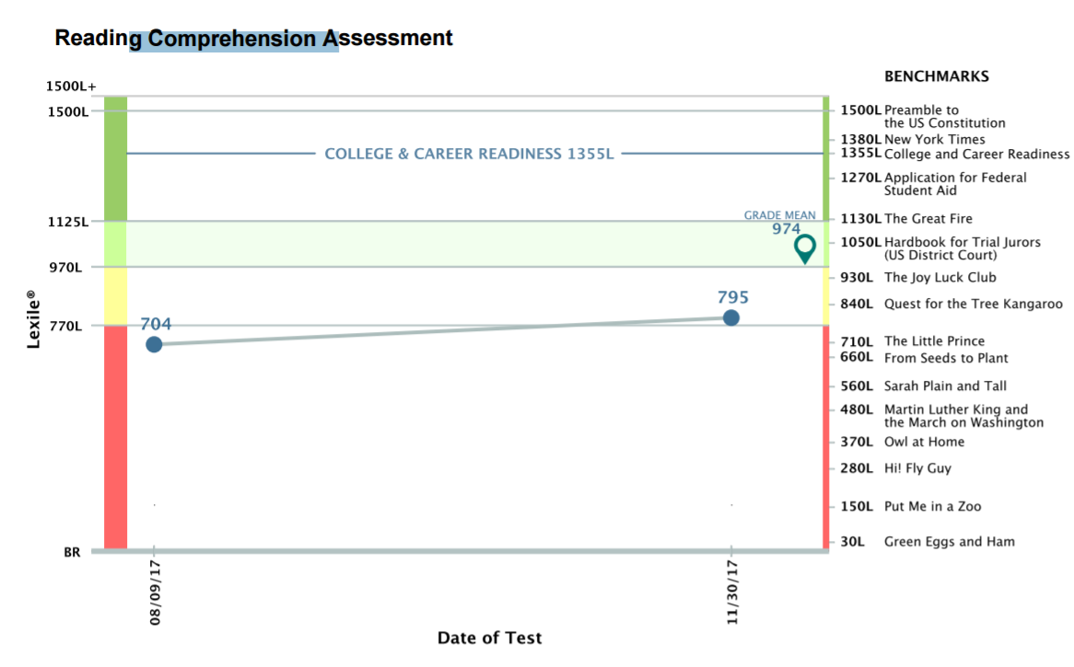
Take a look at the Progress report for RI
Where does your child fall?
What are your child’s current reading habits at home?
How does the December score compare to August? (increase/decrease, from basic to proficient, etc.
What strategies/home habits contributed to the new Lexile score?
What strategies need to continue or be implemented in order to see consistent growth?

Slide 13

Measures a student's level of mathematics knowledge using a Quantile® - like a Lexile Score
A Quantile® indicates how well a student understands skills and concepts along a developmental continuum.
Proficient by the end of the school year is considered to be performing on grade level and on track to meet the demands of college and career by the end of high school.
Quantile measure is like a thermometer: students measure below 0 up to 1600Q (0=emerging mathematicians)
A Quantile measure is aligned to the state standards.
Notes:
Transition to the Math Inventory.
Quantiles are similar to Lexile levels.
The Quantile score helps a teacher gain an understanding as to how ready a student is to meet the current grade level math standards and concepts.
Students who have low score are lacking specific skills that may be required for them to be able to solve problems in their current grade level.

Slide 14

Overall Growth - 2016-2017
Notes:
Scores show the overall growth last year.
Increase in advanced by 3 % and proficient by 14%. A decrease in below basic by 13%.
Area of concern – across grade levels we still have 69% of students scoring and basic or below on the Math Inventory.

Slide 15

6th Grade Growth 2016-2017
Notes:
6th Grade students increased in both students who scored at proficient and advanced and decreased the number of students who scored at basic and below basic.
At the beginning of the school year 85% of our incoming 6th graders scored and basic or below. By the end of the year that percentage was reduced by 18%!

Slide 16
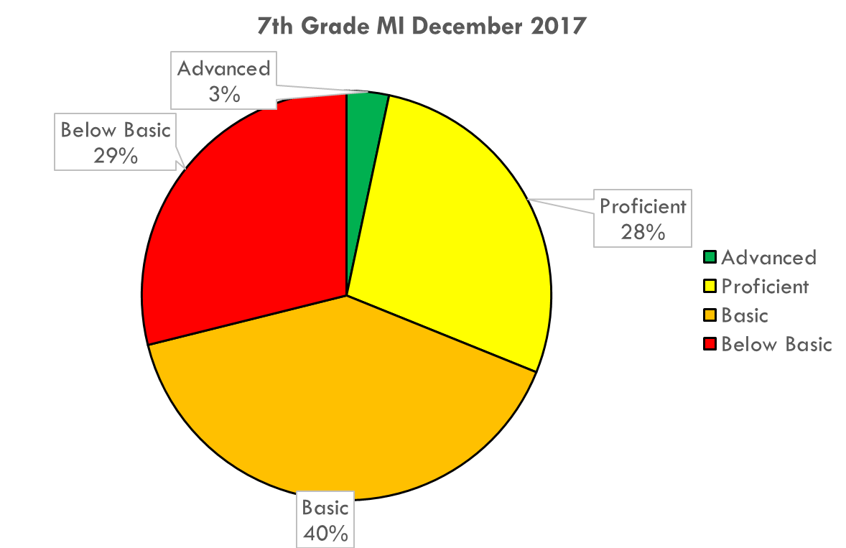
7th Grade Growth 2016-2017
Notes:
7th grade students showed an increase in the number of students scoring at both proficient and advanced. 29% of 7th grade students went to 8th grade ready with the skills ready for 8th grade math.

Slide 17
8th Grade Growth 2016-2017
Notes:
8th grade students last year decreased the percentage of students scoring at basic or below by 9%. An increase of 9 % of students scoring at proficient or advanced.

Slide 18
Why does it matter?
Struggling Students..
will struggle in future classes if gaps are not addressed
lack the ability to problem solve in real life situations
will fall behind as they progress to each grade
will struggle to meet the 4 math credits required to graduate high school
tend to require remedial classes in high school and college (which do not count towards graduation)
A student who is Basic or Below Basic is below grade level and not on track to meet the demands of college and career by the end of high school.
Notes:
Conclude the MI discussion by pointing out why the MI score is so important and what students who struggle in math may face in middle school and later in high school.

Slide 19
Why does it matter?
Advanced Students
Tend to be good critical thinkers and problem solvers
Are able to take higher level math courses in high school, which could transfer to college credit
Are ready to acquire the advanced skills required for 21st century careers
Are often able to take and understand higher levels of science courses
A student who scores at the Proficient or Advanced level by the end of the school year is considered to be performing on grade level, and is on track to meet the demands of college and career by the end of high school.
Notes:
This slide will address parents whose children scored consistently at proficient and higher.

Slide 20

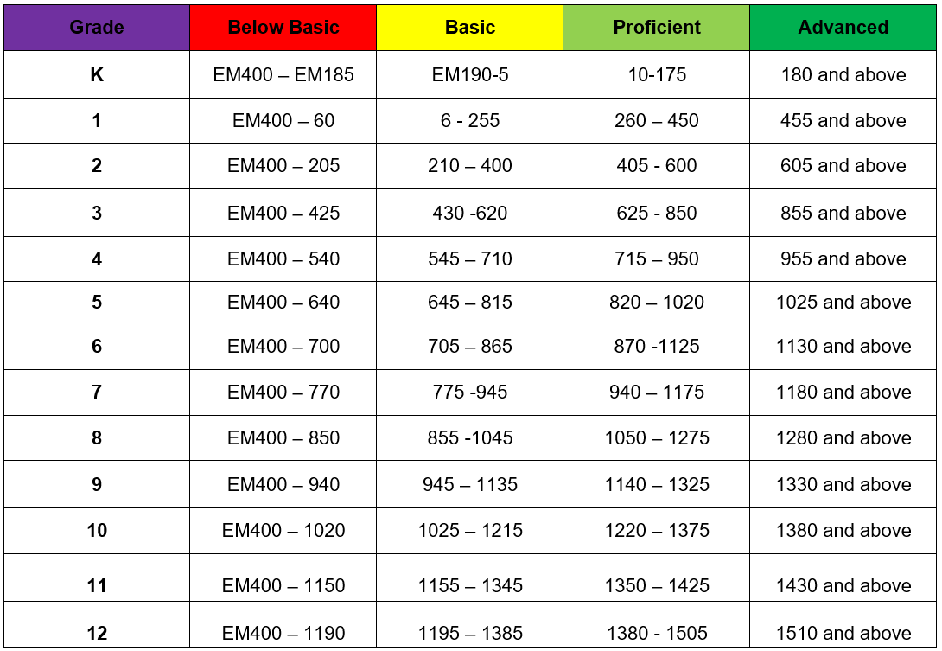
Quantile Proficiency Bands
Purple Sheet
Notes:
Quantile Chart is also on the purple sheet with information about the MI. The chart gives valuable information on how ready a child may be to tackle the math concepts in the next grade level.
For example by the end of 5th grade students who have a score between 820-1020 (proficient) by the end of 5th grade are prepared for the math concepts in 6th grade.

Slide 21
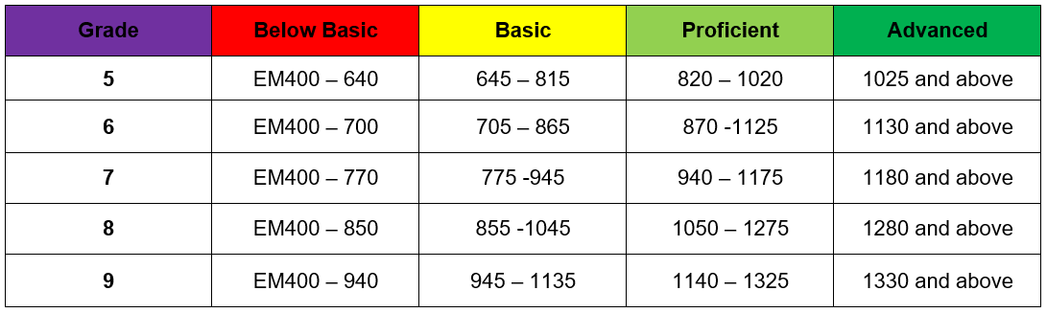
Quantile Proficiency Bands
Notes:
At this point in the presentation parents will revisit their reflection sheet, this time looking at the MI report. The MI report is different from the RI in that it gives the progression of scores from last year to this year.
Remind parents to take a look at the trend they see in their child’s score and then use the chart to determine whether their child is prepared to the current grade level math concepts.
Students who score and below basic or basic often need to practice basic math skills such as multiplication facts, addition, subtraction, etc.

Slide 22

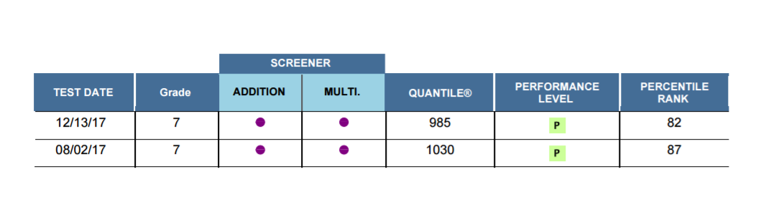
How does the December score compare to August?
What trends to you see in your child’s score over this year?
What strategies need to be implemented or continued in order to see continued growth?
Green Sheet

Slide 23
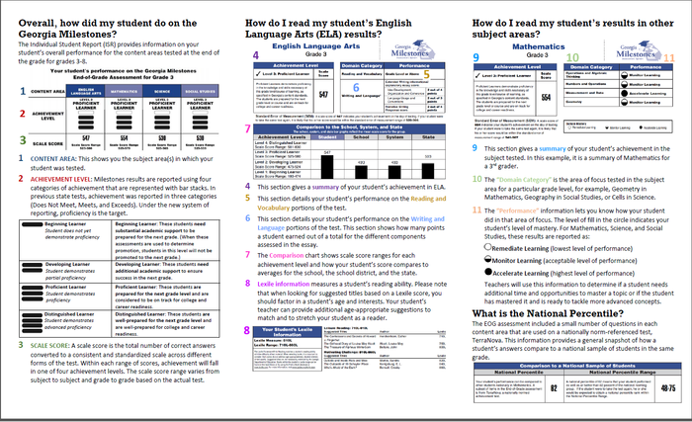
Notes:
This slide shows an overview of the milestones report that they have in their folder.
**It will be important to mention that some students do not have their milestone scores. This may be due to their transferring from another school or not taking the test last year.

Slide 24
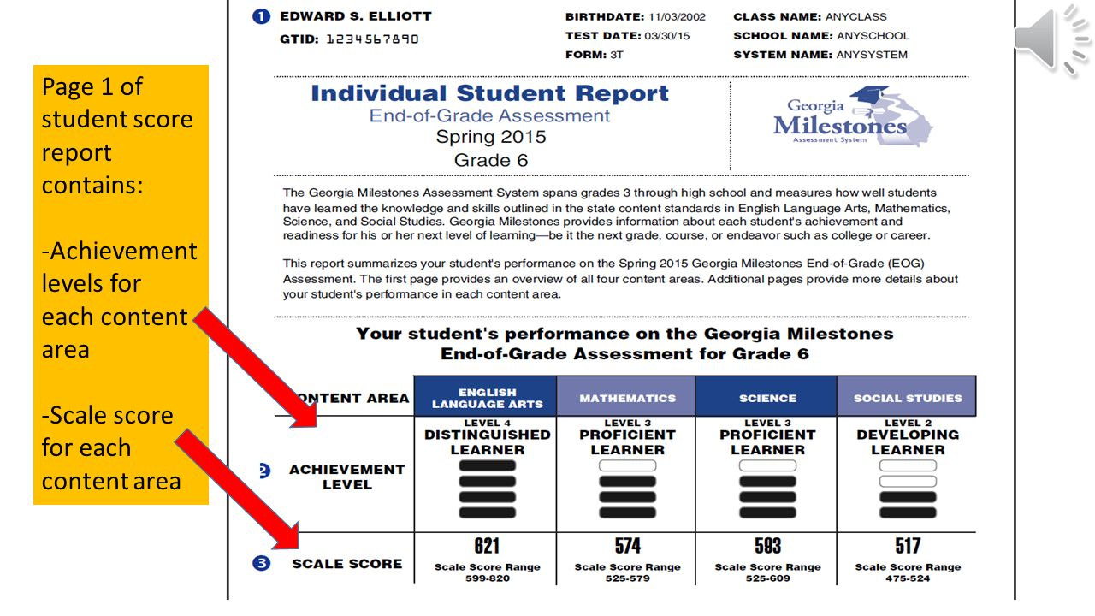
Notes:
Explain that for this meeting we will be looking at the achievement levels and what they indicate for their child.
Remind parents that the only grade that takes all 4 content areas are 5th and 8th grades. For that reason 7th and 8th grade students will only have achievement levels for Math and English Language Arts.

Slide 25

What do the levels tell us?
Pink Sheet
BEGINNING LEARNERS (Level 1)
Lack important knowledge and skills to be successful in this subject.
Need substantial support to be ready for the next grade level or course.
DEVELOPING LEARNERS (Level 2)
Have some of the knowledge and skills necessary in this subject.
Need additional support to be prepared for the next grade level or course.
PROFICIENT LEARNERS (Level 3)
Have the knowledge and skills to be successful in this subject.
Are prepared for the next grade level or course.
DISTINGUISHED LEARNERS (Level 4)
Have advanced knowledge and skills in this subject.
Are well prepared for the next grade level or course.
Notes:
Use this slide to explain each level. This slide can stay up while parents reflect on their own child’s scores.

Slide 26
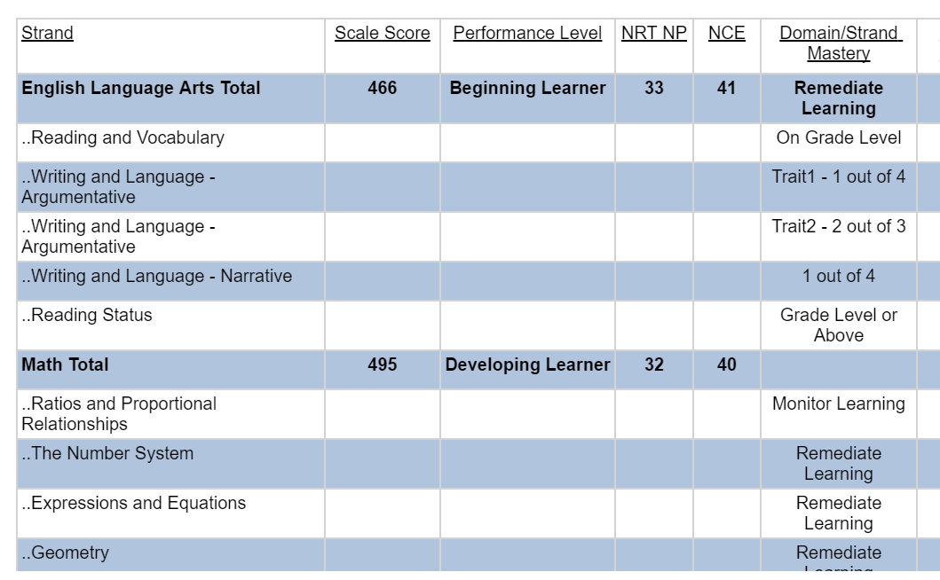

Slide 27
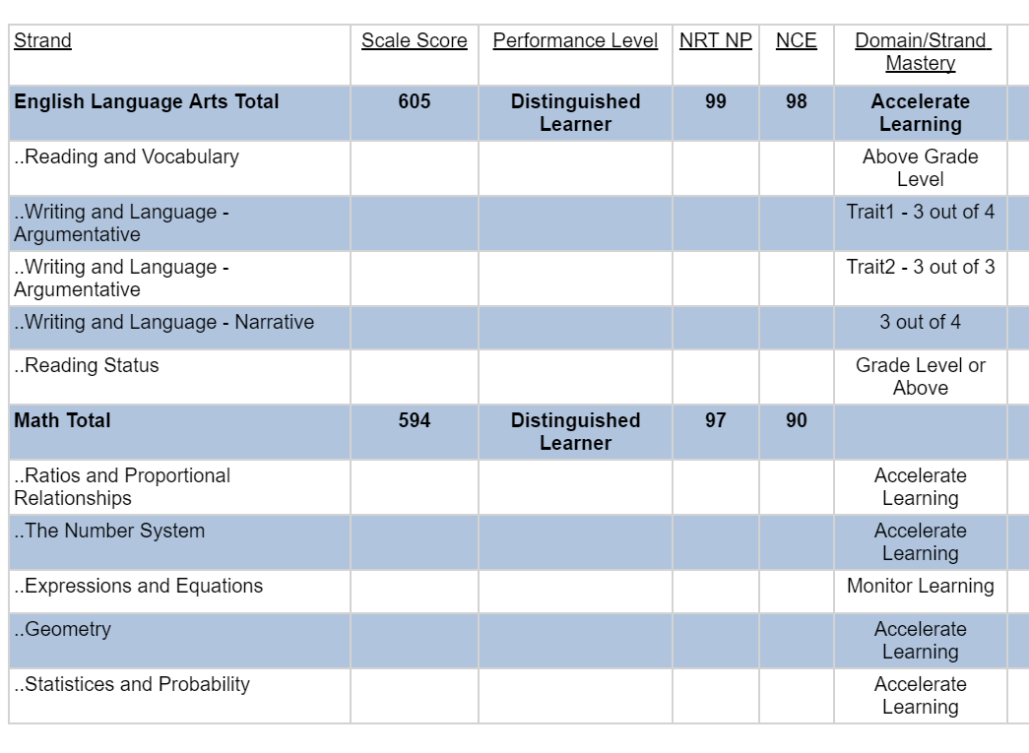

Slide 28
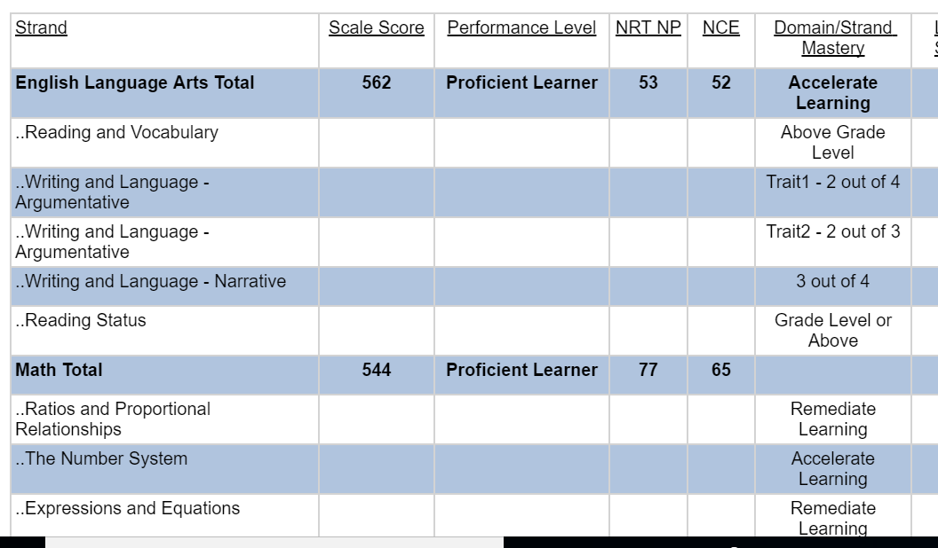

Slide 29
EOG – Reading/Evidence Based Writing Assessment
Day 2 of ELA section
Students read 2 short texts
Given a writing task (Informative/Explanatory; Argument/Opinion)
Students write an essay answering the writing prompt, using evidence from the 2 short texts.

Slide 30
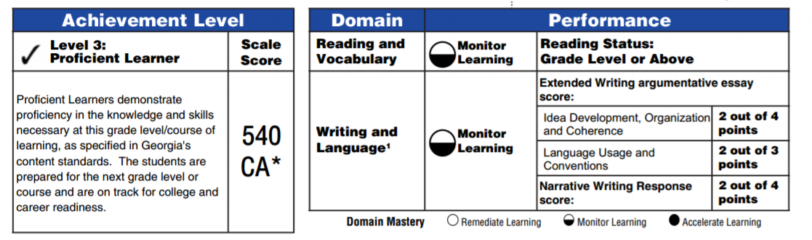

Slide 31
Scoring Rubric: Two Traits
Idea Development, Organization, Coherence – 4 points
Language Usage and Conventions – 3 points
Topic/Ideas
Introduction
Organizational Structure
Use of transitions
Counter-Claim (argument only)
Conclusion
Supporting Details
Reasons, text evidence, facts, details, etc.
Varies sentence patterns
Demonstrates command of conventions
Minimal errors
Notes:
Look at the rubric

Slide 32
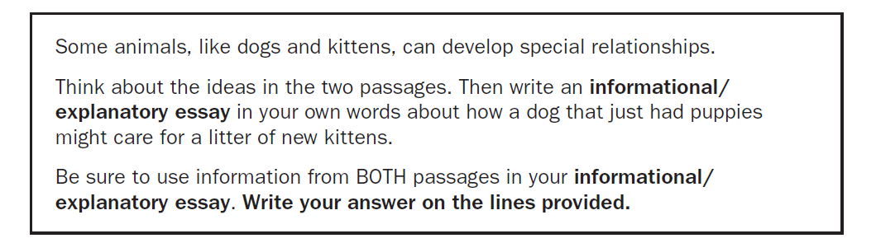
Writing Task
7

Slide 33
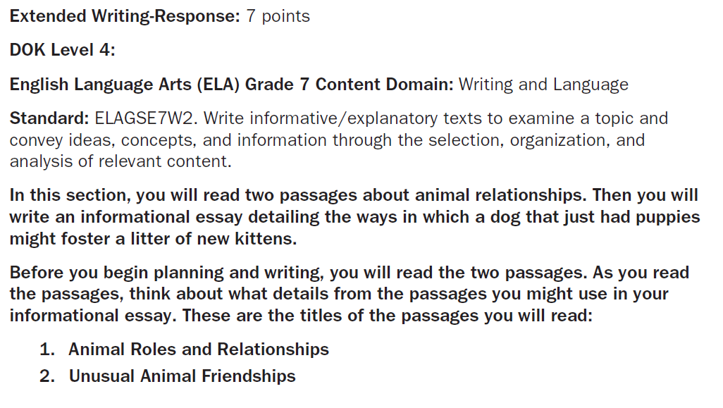

Slide 34
Current 8th Grade
Idea Development, Organization, and Coherence
0-Response is flawed | 1-Beginning | 2-Developing | 3-Proficient | Distinguished
4 | 15 | 49 | 26 | 7
Language Usage and Conventions
0 | 1 | 2 | 3
4 | 14 | 47 | 34

Slide 35
Current 7th Grade
Idea Development, Organization, and Coherence
0-Response is flawed | 1-Beginning | 2-Developing | 3-Proficient | Distinguished
5 | 15 | 63 | 15 | 3
Language Usage and Conventions
0 | 1 | 2 | 3
5 | 8 | 69 | 18

Slide 36


Reflect on the Milestones Data
How do the scores on the EOG/Milestones compare to that of the RI and MI?
Are you surprised by the scores?
What are your child’s strengths?
What are their weaknesses?
Notes:
These questions are on the reflection sheet, so it may be a good idea to go back to the achievement levels slide after talking through the questions.
*When comparing the scores of the RI or MI to the Milestones it may be helpful to clarify with the following questions: Does the RI score reflect a similar achievement level on the RI. For example: If my child scored at below basic on the MI and at a level 1 – or beginning learner on the Math section it would make sense that their math skills are an area that needs substantial support.
*Scores that might surprise them may be if the RI score was at proficient and the Milestone score was at developing. What other factors may impact that score?

Slide 37


Planning A Way to Success
Specific
What is your goal? How often or how much? Where will it take place?
Measurable
How will you measure your goal? Measurement will hold you accountable?
Attainable
Goals should push you, but it is important that they are achievable. What actions will you take?
Realistic
Is this goal reachable? How do you know?
Timely
Do you have a timeframe listed in your SMART goal? This will help you be motivated.
Notes:
Review what is meant by a SMART goal. Explain that the next step is to take the reflection on the data and turn it into a specific, attainable and realistic goal for their child.
The questions next to each of the SMART goal criteria will help them to think about the kind of goal they want to write.
The next slide gives some examples!

Slide 38
Some examples
Over the next 3 months we will increase Johnny’s Lexile score from 764 to 804, a 50 point increase, we will know that we have reached our goal by the Reading Inventory in December. To reach this goal we will need to set aside a time to read everyday.
Over the next 3 months we will increase Susie’s Quantile score from 540-650, we will know that we have reached our goal by the Math Inventory in December. To reach this goal we will need to practice basic math facts everyday.
Notes:
The goals reflect each part of the SMART goal. The next slide provides parents with a frame to use to write their goals

Slide 39
SMART Goal Frame
Green Sheet
Over the next ________________________(time), we want to ___________________ (specific), we will know we have reached our goal by __________________ (measure).
To reach this goal we will need to ____________________________. (attainable, realistic)
If needed, don’t be afraid to set more than one goal!
Notes:
The sentence frame will be helpful as parent/students try to set a SMART goal. The SMART goal worksheet is on the back of the reflection sheet. It will probably be helpful to keep the frame up for parents to use as they write a goal.

Slide 40

Strategies for Reading Success
Reading
Online Resources
Set aside at least 20 minutes every day to read!
Ask questions about what your child has read.
Use Lexile level to guide reading choices.
Use online resources to motivate and build vocabulary.
Share your reading interests!
Free Rice (Vocabulary building)
Lexile Framework for Reading (Check Lexile levels
Wonderopolis (Non-Fiction texts on a variety of topics)
Newsela Learning & Support (Instructions on how to sign up for a Newsela account – great non-fiction reading resource)
http://www.adlit.org/ (Adolescent Literacy resource for parents and educators.
Notes:
Overview of what they will find on the strategy handout. Parents will take a handout of resources they can use at home to help their child reach the SMART goal they set. If time permits may choose a few of the hyperlinks to share with parents. If not remind them that this PowerPoint will be available on Cooper’s homepage.

Slide 41
Strategies for Math Success
Math
On-Line Resources
Practice your multiplication and addition facts daily. (1-20)
Ask your child to explain what they are doing.
Ask your child to help you solve household math problems (baking, balancing the checkbook, which is the best deal)
Use online resources to motivate and explain concepts.
Do at least 5 practice problems a night.
CHECK THE BLOG FOR RESOURCES AND CONTACT
Online textbook www.connected.mcgraw-hill.com / username: ccsd(lunch #), password: cobbmath1
Khan Academy www.khanacademy.com - you can search a specific topic or search by subject (Math 6,7,8) for full curriculum map of instruction
USA Test Prep www.usatestprep.com / username: First.Last Name/ Password: Lunch number
Check your students MI score on Quantiles.com for resources www.quantiles.com
Notes:
Overview of what they will find on the strategy handout. Parents will take a handout of resources they can use at home to help their child reach the SMART goal they set.

Slide 42
Our Learning Commitments
Parent
Student
What will you do to help your child meet the goals that you set?
Ex.
Set aside time for practice each night.
Check for homework completion
Help look for appropriate level books
Ask questions about reading
What will you do to help you meet the goals that you set?
Ex.
I will find and read a book at my Lexile level
I will practice multiplication facts each night
I will do my math homework each night
I will set aside at least 20 minutes to read.
Notes:
Finally, encourage parents to use the Learning Commitments organizer in their folder to discuss how they will commit to meeting the goal that they set. They can then place the learning commitments and goals in a prominent place at home (refrigerator) to remind them.

Slide 43

Next Steps
Explore On-Line resources
Check Synergy and teachers Blogs/Schoology pages often
Revisit goals and commitments often! Hang them on the refrigerator.
Set aside time for reading, writing and practicing math skills in preparation for Georgia Milestones in April
Notes:
As you close the presentation it may be a good time to remind parents about Synergy access and teacher blogs as another tool toward helping their child reach the academic goal they just set.

